Slide 1

Emerging Technologies
Session #08: Using GIT in Bluemix
IBM Bluemix
The Digital Innovation Platform
Sylvain-Roch WILBERT
s_wilbert@fr.ibm.com
Université Paris - Dauphine

Slide 2
GIT in a nutshell: Developping together !
Git
is a free and open source distributed version control system:
A version control system is a piece of software designed to keep track of the changes made to files over time.
Some directives we will use
Commit: Whenever you save your changes to one or more files to history in Git, you create a new commit. Commit message: Every time you make a commit, you need to supply a message that describes why the change was made.
Clone Download a copy of a project from the central Git repository so you can work on it locally.
Add : Adding file to a Git repository
Push : Pushing the local committed file to the central GIT repository

Slide 3
Exercize - GIT basics with Bluemix Deploying an app relying on GIT
Directory : 04-andnowinbluemix
Based on Session #03: Using bluemix to deploy a first application
Objectives of this session is to deploy your code on the cloud, relying on git so that developers can share their implementation
STEP #1: Have a nodeJS Starter application deployed in Bluemix (Session03)
STEP #2: Push the code from 04-andnowinbluemix as an evolution of the application

Slide 4
Exercize – GIT basics Our requirements
Start from a stable ‘cloud-compliant’ application for ex 04-andnowinbluemix
Deploy or reuse a NodeJS Starter application in Bluemix
Add a GIT to this application
Clone the (server) GIT repository on a local directory
Replace the Local code by 04-andnowinbluemix
Perform a GIT ADD
Perform a GIT COMMIT
Perform a GIT PUSH

Slide 5
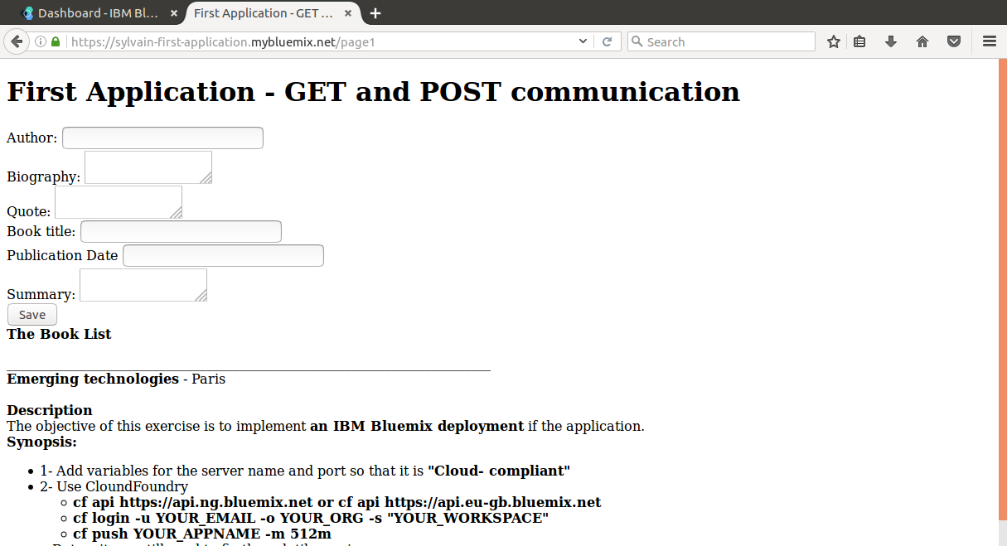
Exercize - GIT basics with Bluemix Deploying an app relying on GIT
Directory : 04-andnowinbluemix

Slide 6
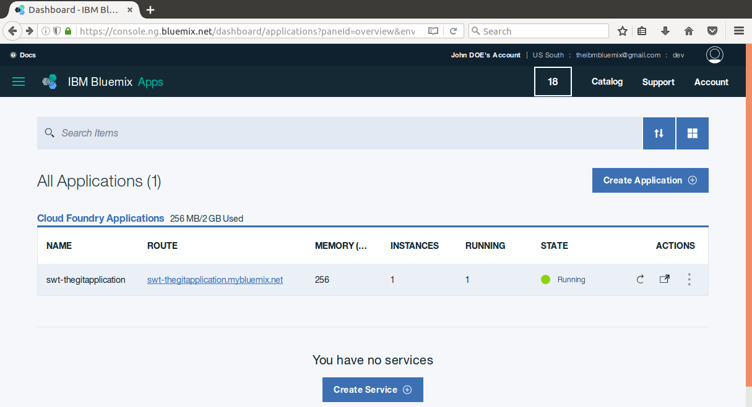
Exercize - GIT basics with Bluemix Deploying an app relying on GIT
STEP #1
From the Bluemix dashboard, reopen the first app, deployed with GIT enabled (Session #3) , or redeploy a new NodeJS application Starter, and edit its code to enable GIT

Slide 7
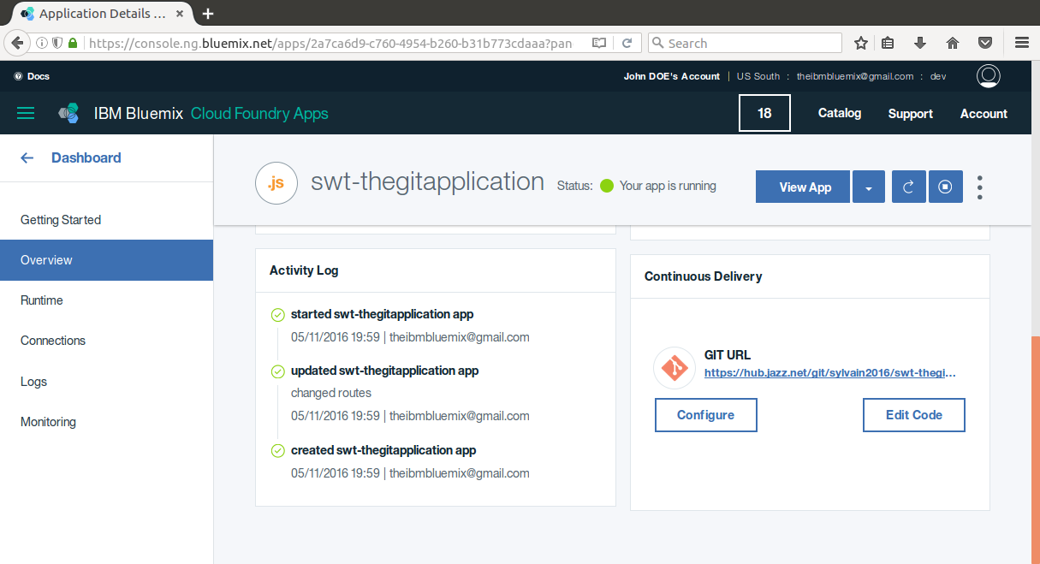
Exercize - GIT basics with Bluemix Deploying an app relying on GIT
STEP #1
Copy the link location of the GIT Repo (Right Click, Copy Link Location)

Slide 8
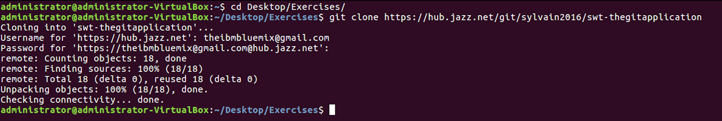
Exercize - GIT basics with Bluemix Deploying an app relying on GIT
Open a terminal go to the Exercises repository
Clone the git repository using
git clone GIT_URL
The source code is downloaded
A new folder is added corresponding to the application retrieved

Slide 9
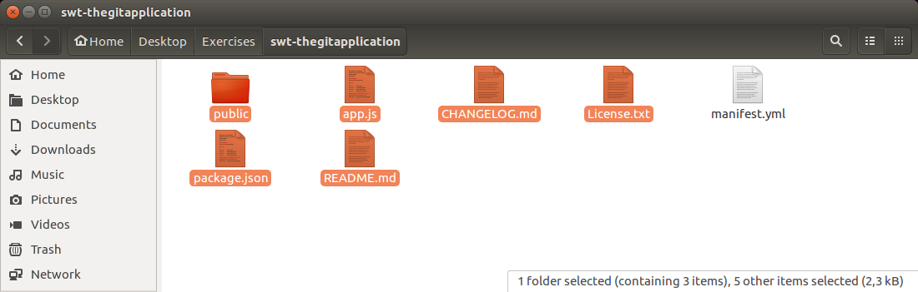
Exercize - GIT basics with Bluemix Deploying an app relying on GIT
Remove all file BUT the manifest.yml
Copy all files from the local 04-andnowinbluemix directory (In the SourceCode)
From a terminal, go to the Desktop/Exercises/APPFROMGIT/ folder
Add all files to the git repository
git add *

Slide 10
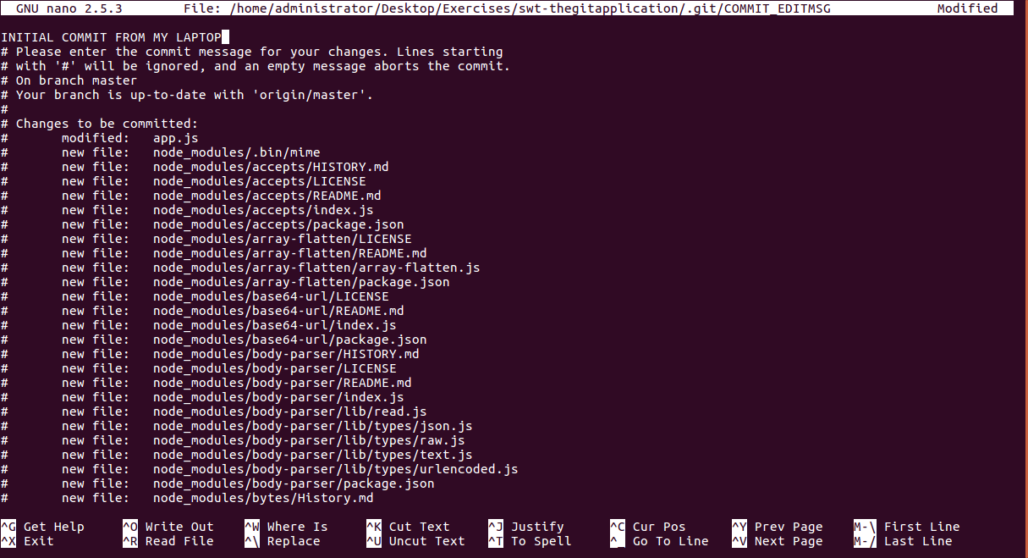
Exercize - GIT basics with Bluemix Deploying an app relying on GIT
Set you identity
git config --global user.email "you@example.com"
Commit all files and add a comment.
git commit

Slide 11
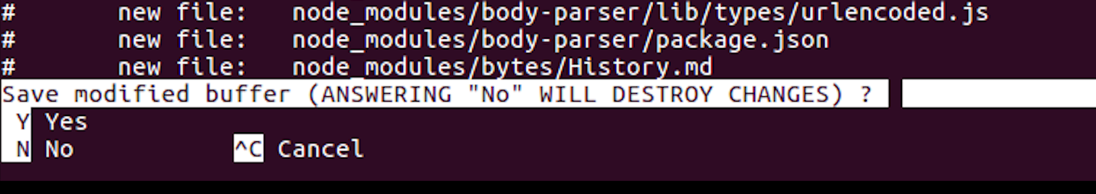
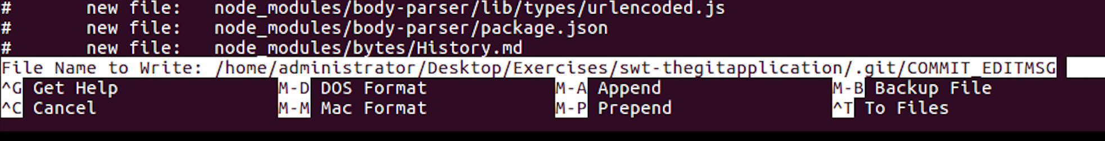
Exercize - GIT basics with Bluemix Deploying an app relying on GIT
Close the editor by clicking
Ctrl+X
« Yes »
Enter

Slide 12
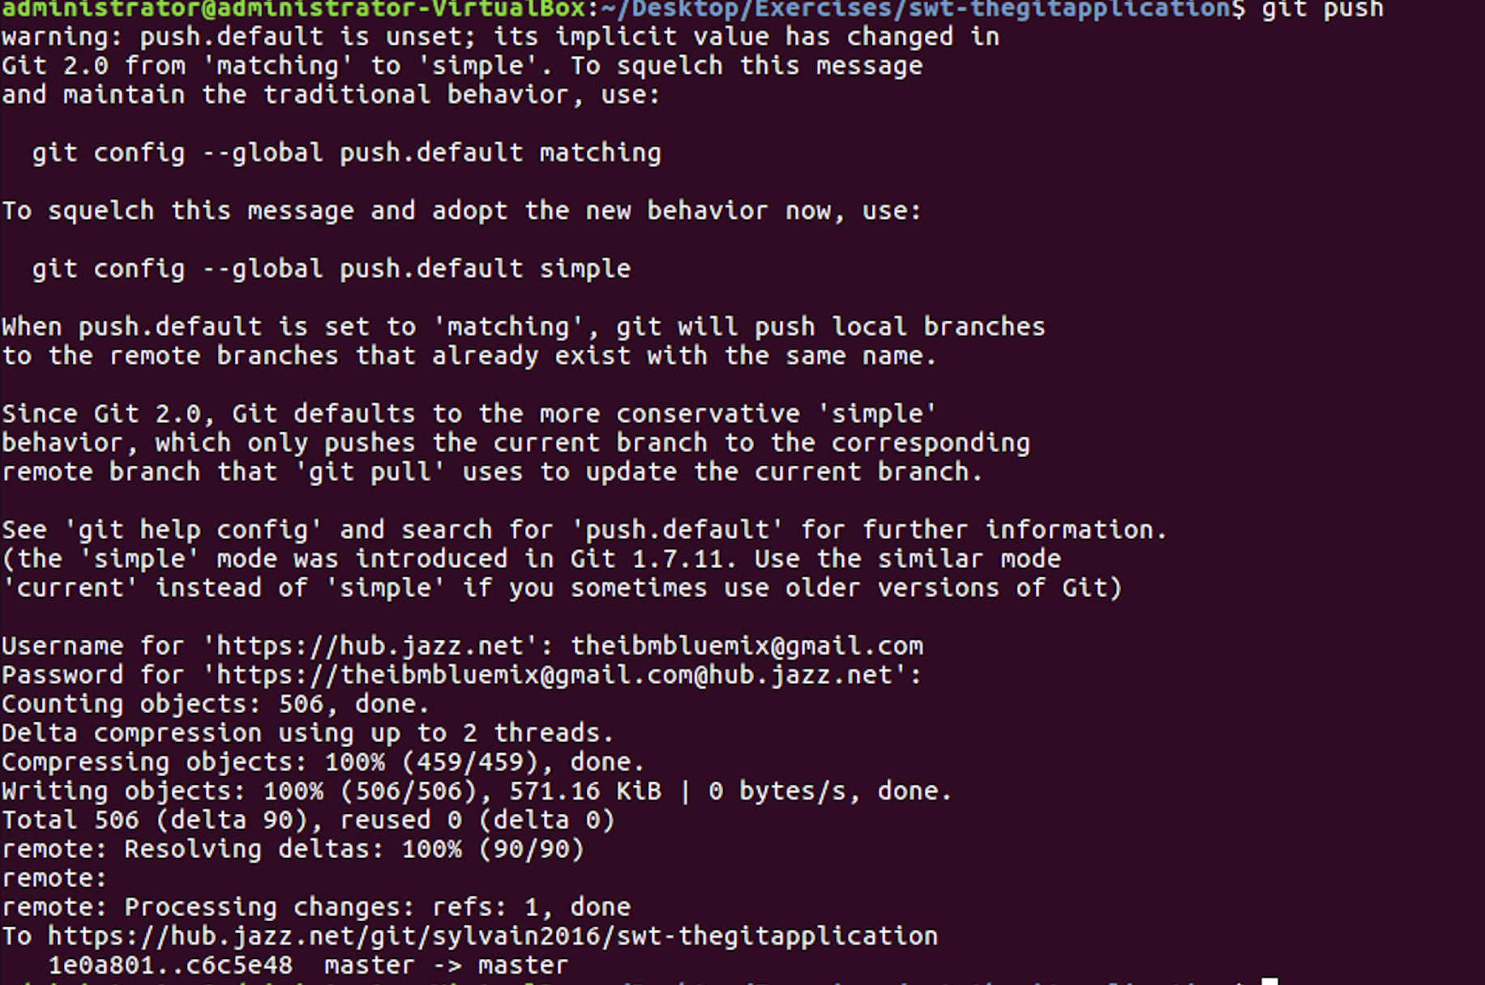
Exercize - GIT basics with Bluemix Deploying an app relying on GIT
Push the changes to Bluemix
git push

Slide 13
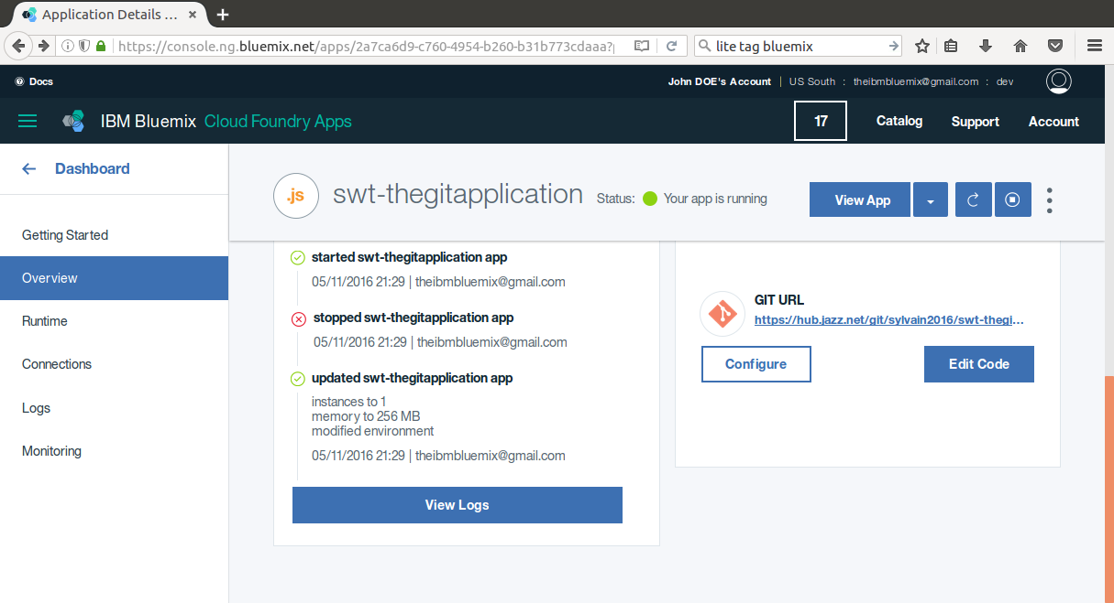
Exercize - GIT basics with Bluemix Deploying an app relying on GIT
1
2

Slide 14
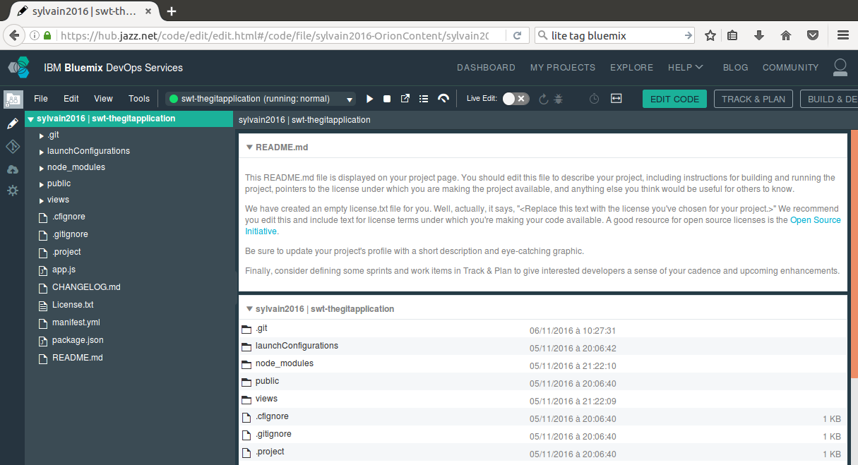
Exercize - GIT basics with Bluemix Deploying an app relying on GIT
1

Slide 15
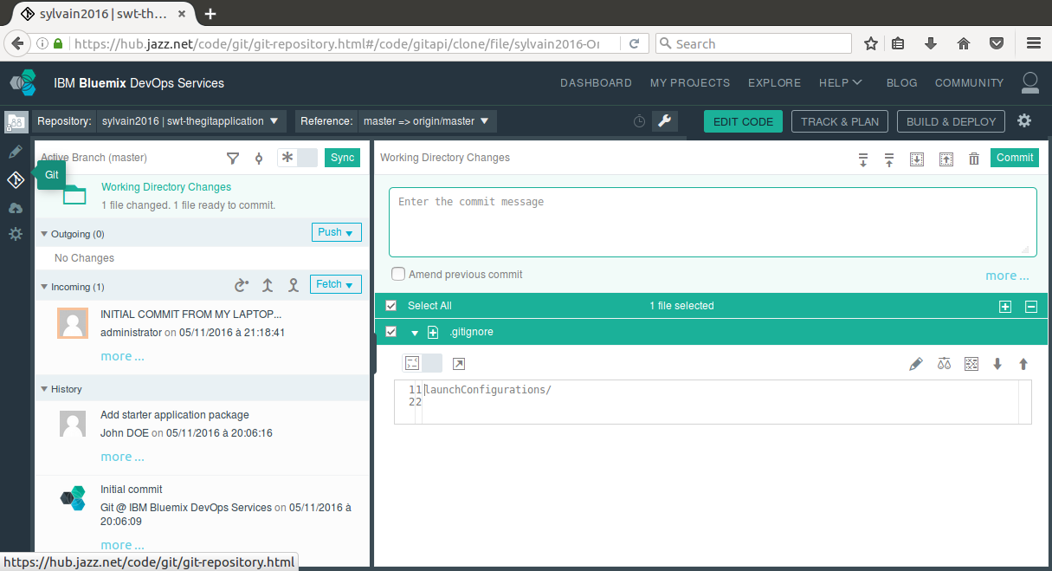

Slide 16
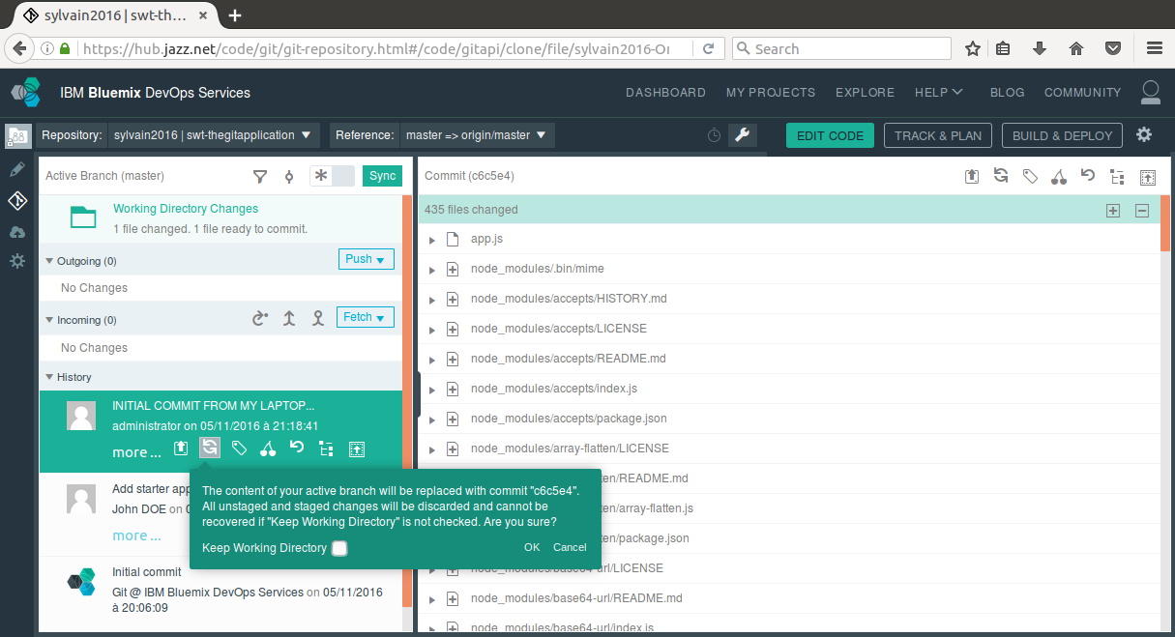
1
2

Slide 17
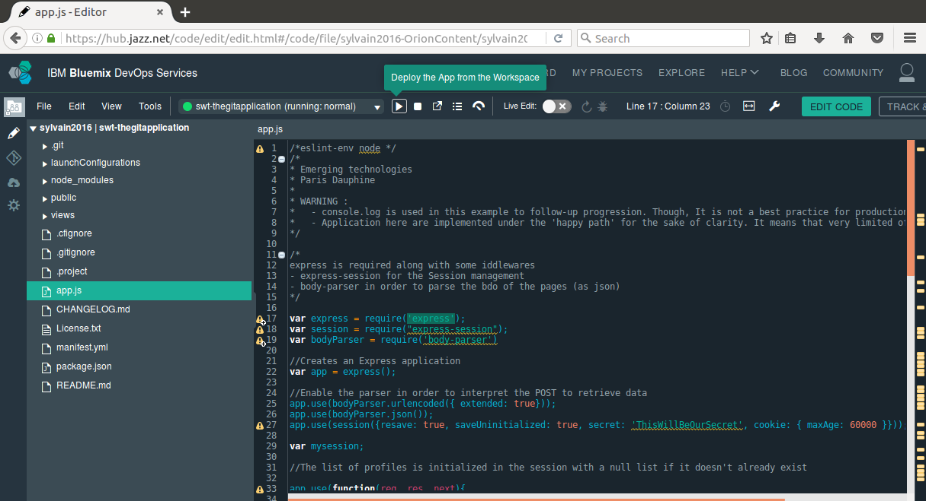
1
2

Slide 18
Exercize - GIT basics with Bluemix Deploying an app relying on GIT

Slide 19
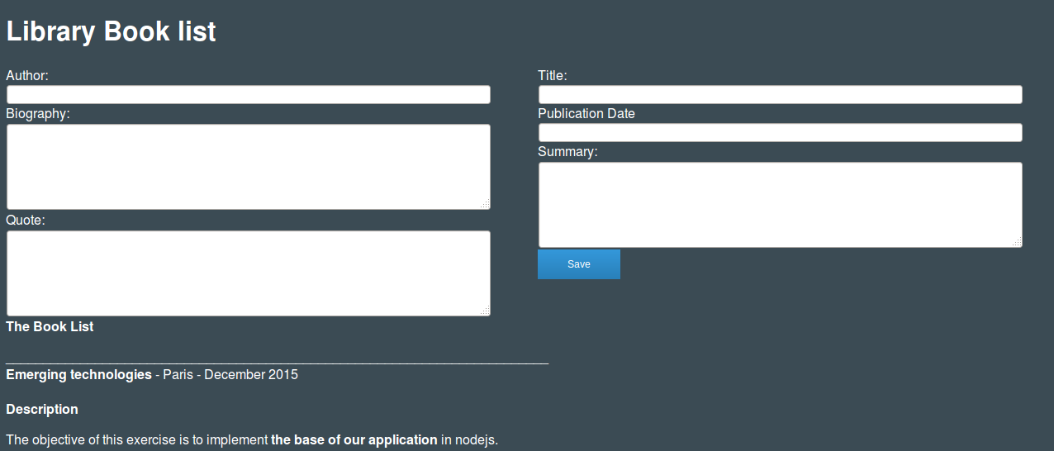
Homework for the next session
Analyze and deploy using GIT in your workspace the 05-intechnicolor

Slide 20

GIT in a nutshell: Developping together !
Clone Download a copy of a project from the central Git repository so you can work on it locally.
git clone GIT_URL
Add : Adding file to a Git repository
git add *
Commit: Whenever you save your changes to one or more files to history in Git, you create a new commit. Commit message: Every time you make a commit, you need to supply a message that describes why the change was made.
(git config --global user.email "you@example.com")
git commit
Push : Pushing the local committed file to the central GIT repository
git push
is a free and open source distributed version control system:
A version control system is a piece of software designed to keep track of the changes made to files over time.

